Slide 1


The immune-modulatory potential of helminth-derived proteins: A systematic review in cellular models of inflammation
¹Sienna Stucke,¹ Aonghus Feeney, ²Richard Lalor, ²Sheila Donnelly, ²John Pius Dalton, ¹Declan McKernan, ¹Eilís Dowd
¹Discipline of Pharmacology and Therapeutics, University of Galway
²Molecular Parasitology Laboratory, Centre for One Health, Ryan Institute, School of Natural Sciences, University of Galway

Slide 2

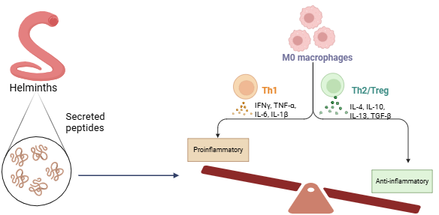
Background
Helminths = parasitic worms that can survive in a variety of hosts for years, evading the immune system
The hygiene hypothesis and ‘old friends’ theories lead to investigation of Helminth-therapy for inflammatory and autoimmune conditions4
Helminth therapy consisted of live inoculation of patients with celiac disease, Crohn’s disease, ulcerative colitis, multiple sclerosis, psoriasis, and arthritis3
Safety and efficacy of live helminth-therapy in clinical trials remained uncertain → driving need to isolate these immunomodulatory for more ‘on target’ effects
Autoimmune/inflammatory conditions
Helminth infections
Helminths secrete a variety of proteins (HDPs) with multiple mechanisms to modulate host immune system, shifting from the Th1 to the Th2/Treg immune response1, 2
preventing antigen presentation
inhibiting cysteine proteases
inhibiting TLR4
inhibiting NLRP3 activation
stimulating IL-10 release
(Smallwood et al., 2021)1, (Versini et al., 2015)2, (Yeshi et al., 2022)3, (Maizels et al., 2018)4

Slide 3
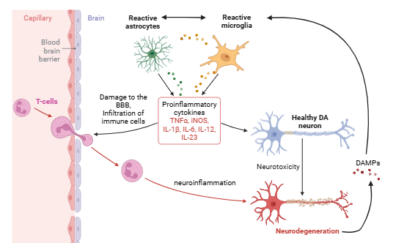
So… How is this relevant to CNS restoration?
HDPs for neuroinflammation?
Neuroinflammation in PD5
Pro-inflammatory cytokine storm
Glial activation
Invasion of immune cells from periphery
Currently: FhHDM-1 increased re-myelination in MS mice6
DA-Neurodegeneration
α-synuclein
Will HDPs have the same immunomodulatory effects in neuroinflammatory models?
Notes:
I know this may seem a bit beyond the scope of NECTAR but my PhD is investigating these peptides for use in neuroinflammation in PD
Understanding the mechanisms and models that these peptides are effective in sets up the rationale for my work

Slide 4
Aims/Objectives
What species have been studied for their helminth-derived peptides?
What is the mechanism of action in these peptides?
How do the peptides alter pro and anti-inflammatory cytokine levels?
Does the cell type or inflammatory stimuli matter?
What other models could these be tested in?
What inflammatory models have these peptides been studied in?
This systematic review aims to synthesize the data on these HDPs and the extent to which they modulate the inflammatory cytokine response in cellular models of inflammation

Slide 5
Methodology
Search strategy
Screening strategy
Inclusion criteria: (1) original research study, (2) helminth peptide/polypeptide, (3) cellular inflammatory model.
Exclusion criteria: (1) review article, (2) not helminth, (3) undefined HDP, (4) not peptide HDP, (5) not tested in inflammatory model and (6) not peer-reviewed or redacted, (7) no cytokine measure, (8) no appropriate control and (9) not in a cellular (in vitro) model
Data extraction
Data analysis
General study characteristics are shown as pie charts and all data related to percent cytokine change are shown as scatter plots depicting individual records with the mean ± standard error of the mean (SEM). Data was analysed using one-sample t-test (with the hypothesised population mean set to zero) or two-way ANOVA, and post-hoc Bonferroni testing was applied where appropriate.
Values were extrapolated from the relevant figure(s) within each article using GetData Graph Digitizer software
Search string: helminth AND secret* AND (immunomod* OR immunosup* OR antiinflam*)

Slide 6
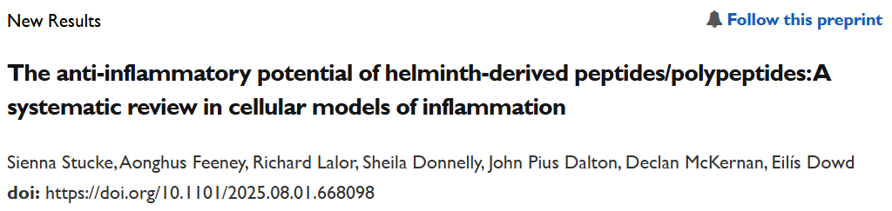
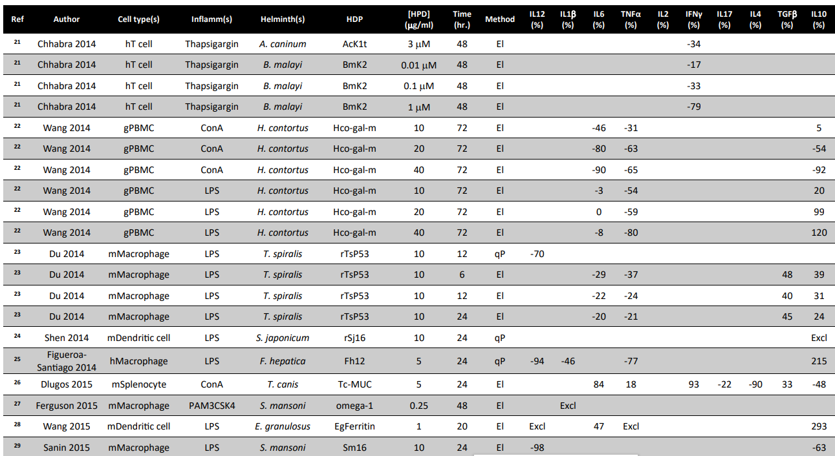
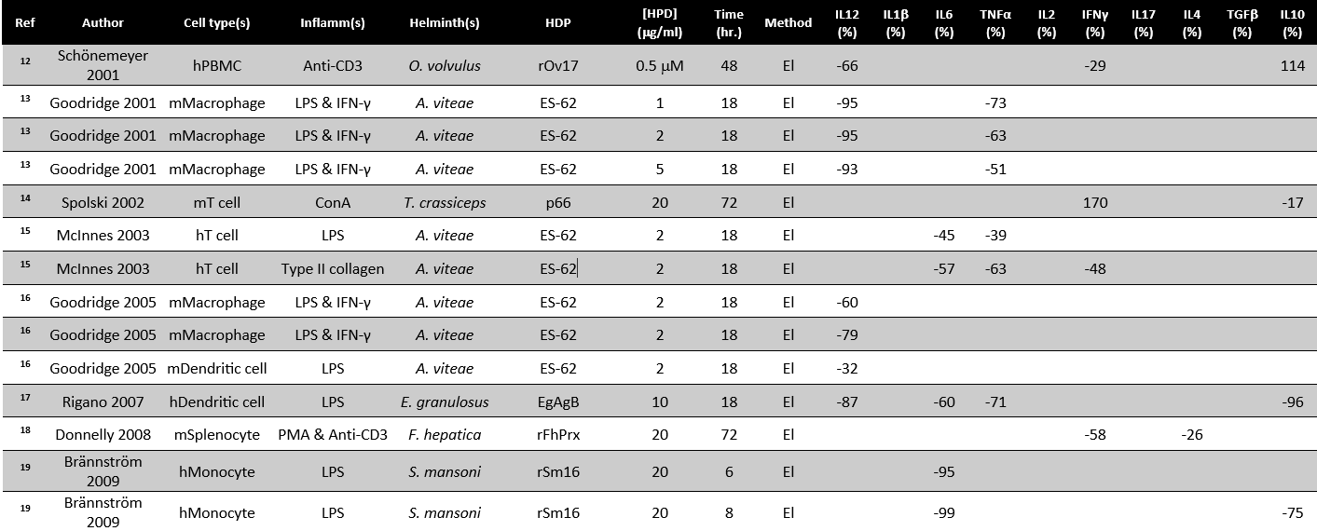
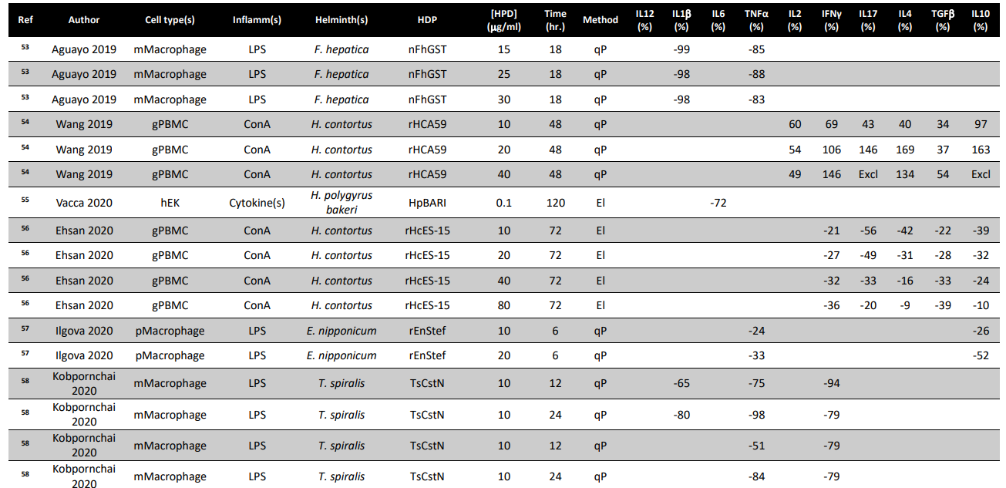
Results
Notes:
As you can see there are a lot of results!
I have the cell type, inflammatory stimulus, helminth species, HDP, incubation timeframe, and measure method for each study
I calculated the percent change in each cytokine measured to see how these HDPs impacted inflammatory cytokine signaling

Slide 7
Results
Effect of cell type on efficacy of HDPs
General study characteristics
Effect of HDPs on cytokines overall
Effect of helminth species on cytokines
Effect of inflammagen on cytokines
Notes:
Mostly macrophages and PBMCs
Overall sig decrease in proinflam cytokines and increase in anti-inflam cytokines
Inflam stimulus didn’t seem to make a difference

Slide 8
Key Takeaways
Will HDPs have the same immunomodulatory effects in neuroinflammatory/neurodegenerative conditions?
HDPs reduce levels of proinflammatory cytokines
  Across multiple species
  Across multiple functional classes
  Especially in macrophages
Some HDPs also increase levels of anti-inflammatory cytokines
  Cysteine protease inhibitors
Gaps in the literature
  Cell type: mostly macrophages and PBMCs
    Only one study looked at microglia
  Inflammatory stimulus: mostly LPS
Notes:
LPS acts at TLR4

Slide 9
Future Directions
In vivo systematic review to evaluate efficacy of HDPs in variety of disease models
Evaluating immunomodulatory effects in an in vitro model of neuroinflammation with immortalized neural and glial cell lines
Evaluating immunomodulatory effects in an in vitro model of neuroinflammation with primary VM cultures
Evaluating immunomodulatory effects in an in vivo model of neuroinflammation
Notes:
This is what my PhD is looking into
In progress

Slide 10
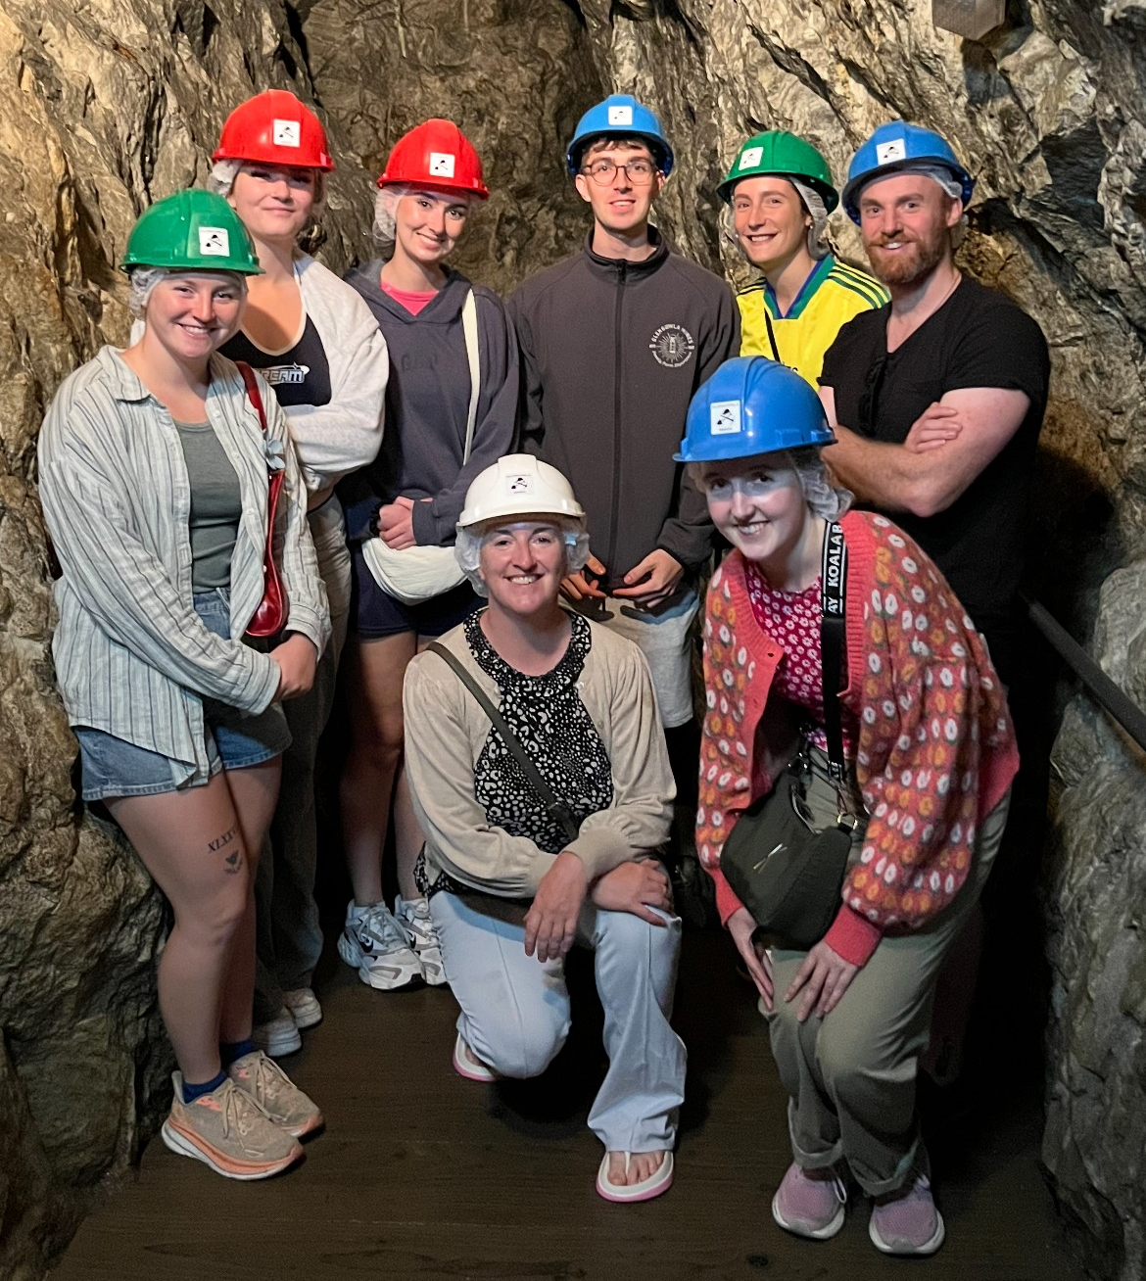
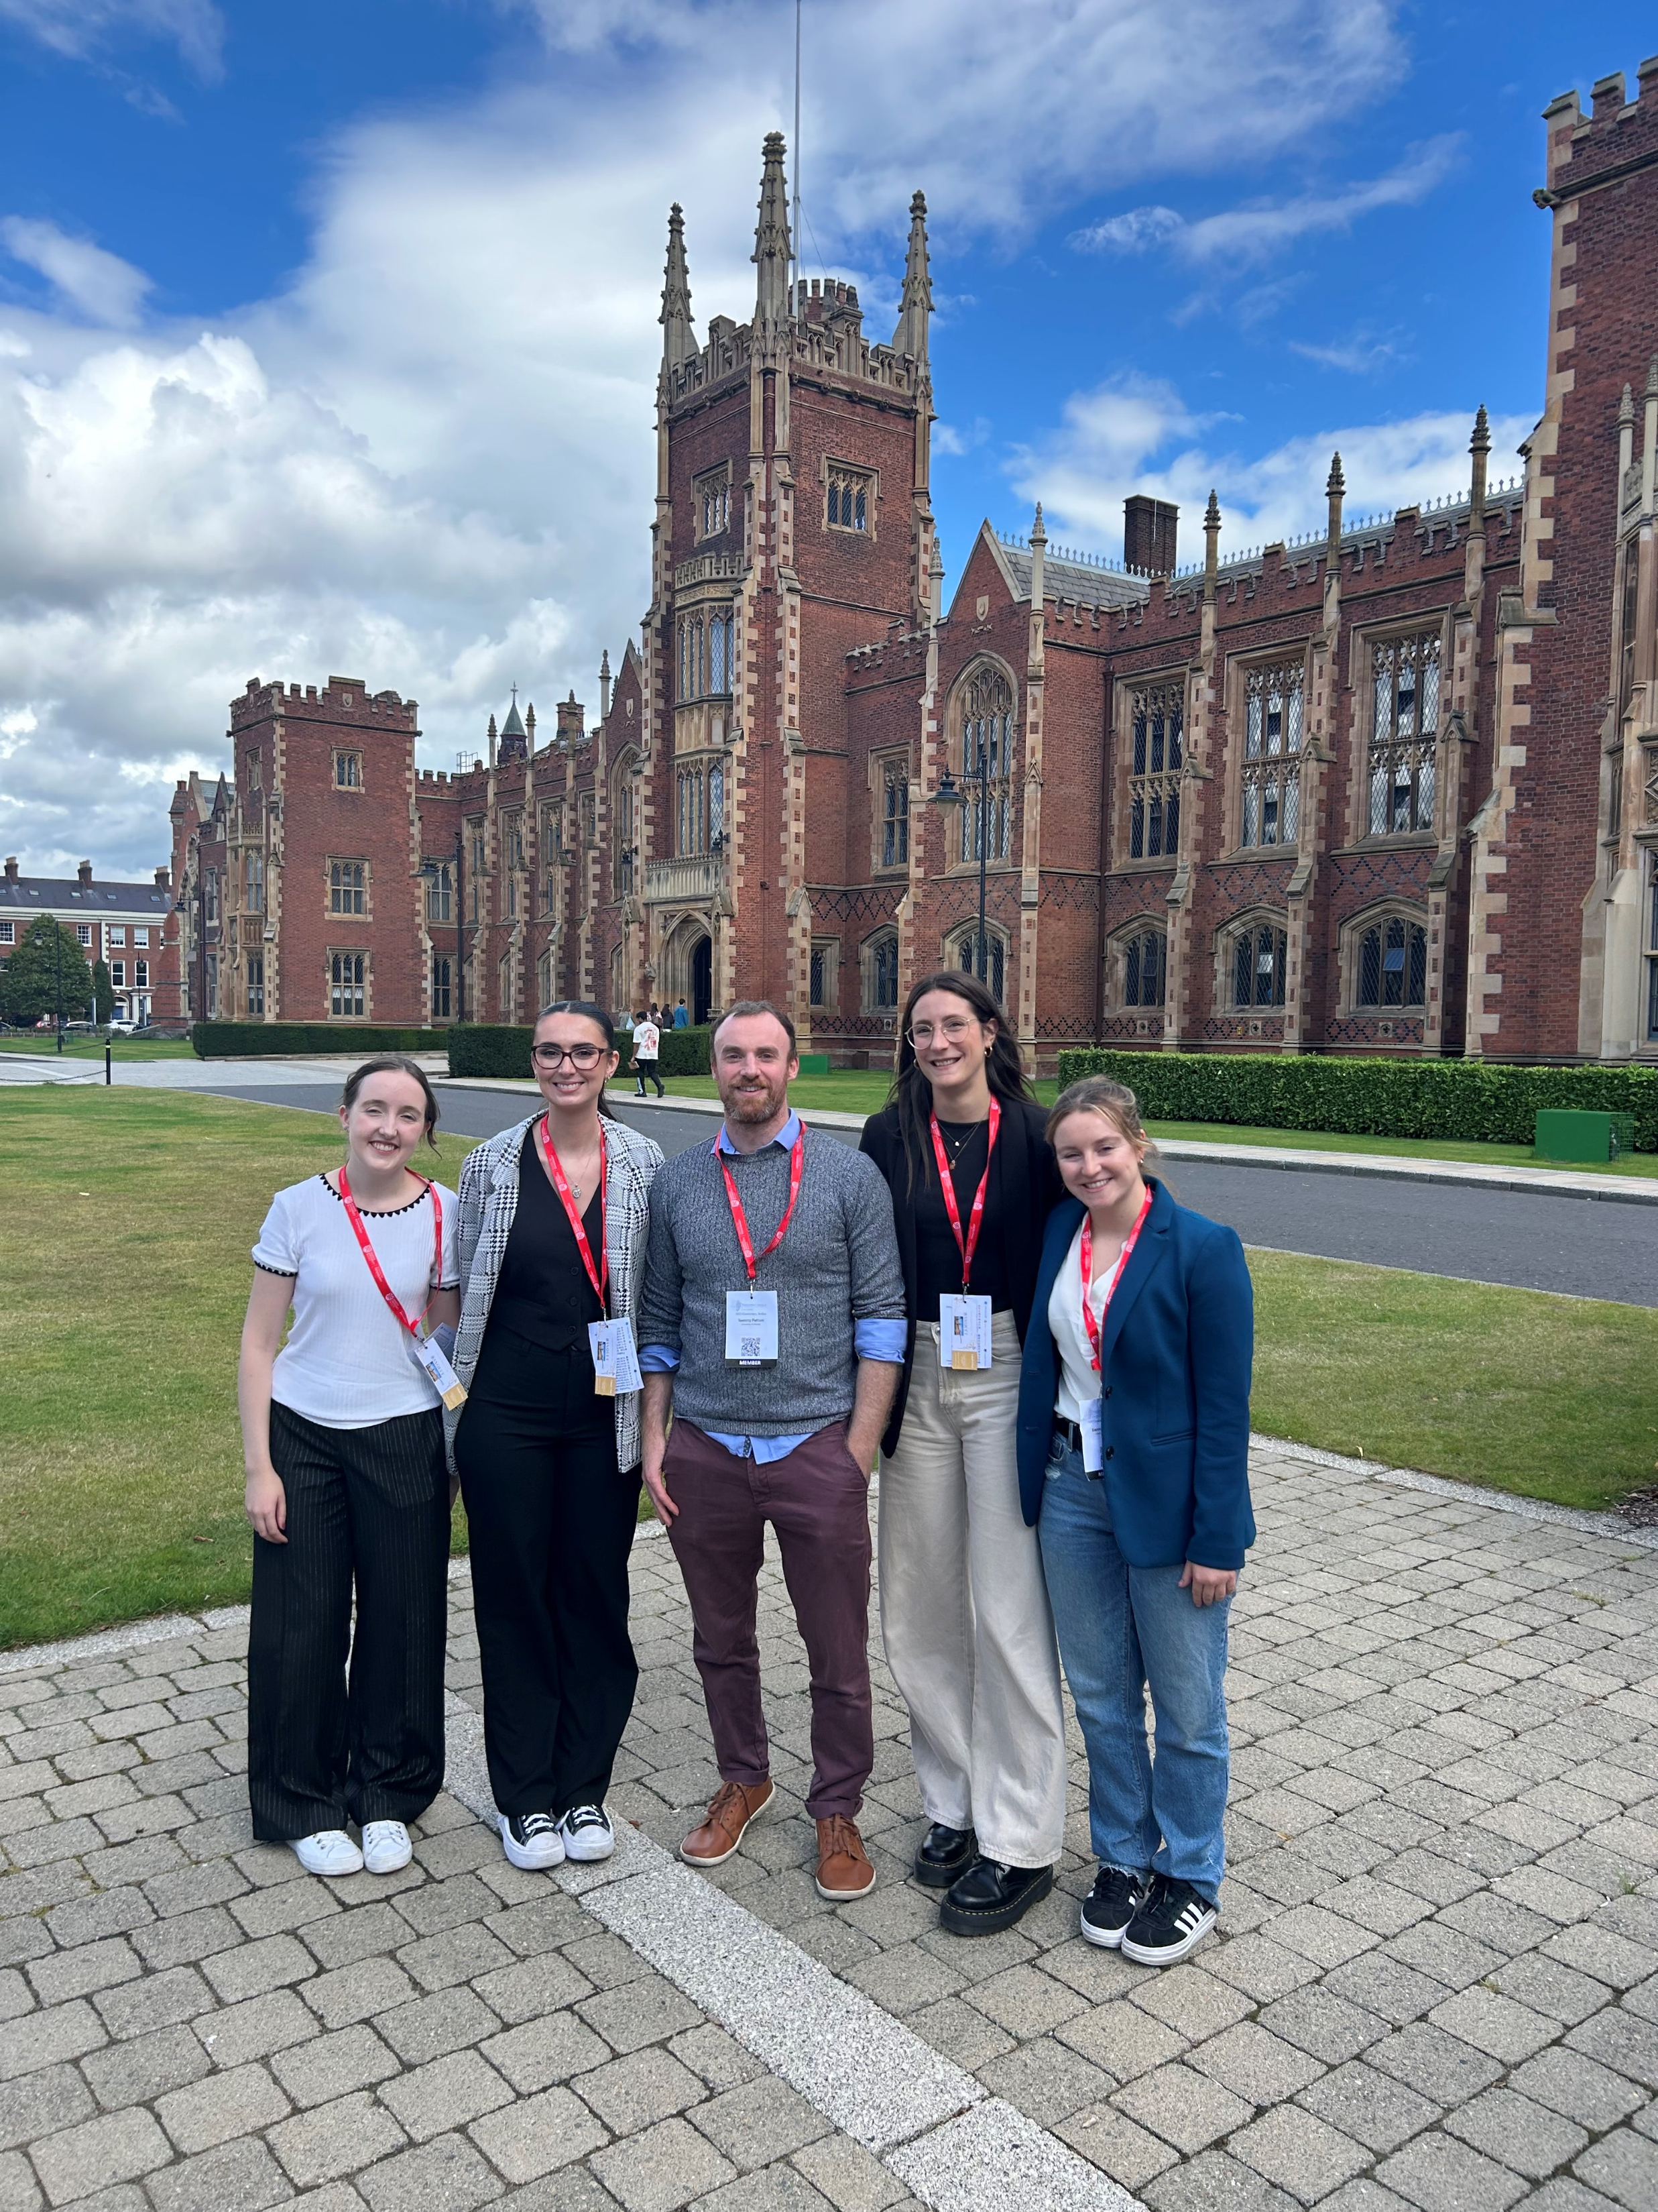
Acknowledgements
Supervisors: Prof. Eilis Dowd and Dr. Declan McKernan
NUIG Department of Pharmacology
Dowd group: Giulia, Tommy, Sarah, Saoirse, Robyn, and Aonghus
Safety and technical staff
Collaborators in NUIG Parasitology
John Dalton, Sheila Donelly, and Richard Lalor
Funding
Tony & Peigí O’Donoghue Parkinson’s Disease Research Award
Galway University Foundation
Thank you!

Slide 11

References
Yeshi, Karma & Ruscher, Roland & Loukas, Alex & Wangchuk, Phurpa. (2022). Immunomodulatory and biological properties of helminth-derived small molecules: Potential applications in diagnostics and therapeutics. 10.3389/fpara.2022.984152.
Maizels, R. M., Smits, H. H. & McSorley, H. J. Modulation of Host Immunity by Helminths: The Expanding Repertoire of Parasite Effector Molecules. Immunity 49, 801-818, doi:10.1016/j.immuni.2018.10.016 (2018).
Smallwood, T. B. et al. Synthetic hookworm-derived peptides are potent modulators of primary human immune cell function that protect against experimental colitis in vivo. J Biol Chem 297, 100834, doi:10.1016/j.jbc.2021.100834 (2021).
Versini, M. et al. Unraveling the Hygiene Hypothesis of helminthes and autoimmunity: origins, pathophysiology, and clinical applications. BMC Med 13, 81, doi:10.1186/s12916-015-0306-7 (2015).
Nguyen LTN, Nguyen HD, Kim YJ, Nguyen TT, Lai TT, Lee YK, Ma HI, Kim YE. Role of NLRP3 Inflammasome in Parkinson's Disease and Therapeutic Considerations. J Parkinsons Dis. 2022;12(7):2117-2133. doi: 10.3233/JPD-223290. PMID: 35988226; PMCID: PMC9661339.
Lalor R, Tanaka A, Shiels J, Dixit A, Hoadley S, Dufourd E, Hamon S, To J, Taggart CC, Weldon S, O'Brien B, Greer J, Dalton JP, Donnelly S. An immunoregulatory amphipathic peptide derived from Fasciola hepatica helminth defense molecule (FhHDM-1.C2) exhibits potent biotherapeutic activity in a murine model of multiple sclerosis. FASEB J. 2025 Feb 28;39(4):e70380. doi: 10.1096/fj.202400793RR. PMID: 39950309; PMCID: PMC11826375.
Sienna Stucke, Aonghus Feeney, Richard Lalor, Sheila Donnelly, John Pius Dalton, Declan McKernan, Eilís Dowd. The anti-inflammatory potential of helminth-derived peptides/polypeptides: A systematic review in cellular models of inflammation doi: https://doi.org/10.1101/2025.08.01.668098 (Submitted for publication)
Check out the paper!
Come find me at my poster!

